Slide 1

Mastery in Mathematics

Slide 2
What is Mastery?
Deep and sustainable learning in small steps
The ability to build on something that has already been learnt.
The ability to reason about a concept and make connections.
To have conceptual and procedural fluency.

Slide 3
How is depth achieved in Maths?
Longer time on maths topics
Intelligent practice (variation with small steps)
Detail in exploring the concept - all aspects exposed and linked (coherence)
Questioning and activities develop reasoning and make connections
(mathematical thinking)

Slide 4
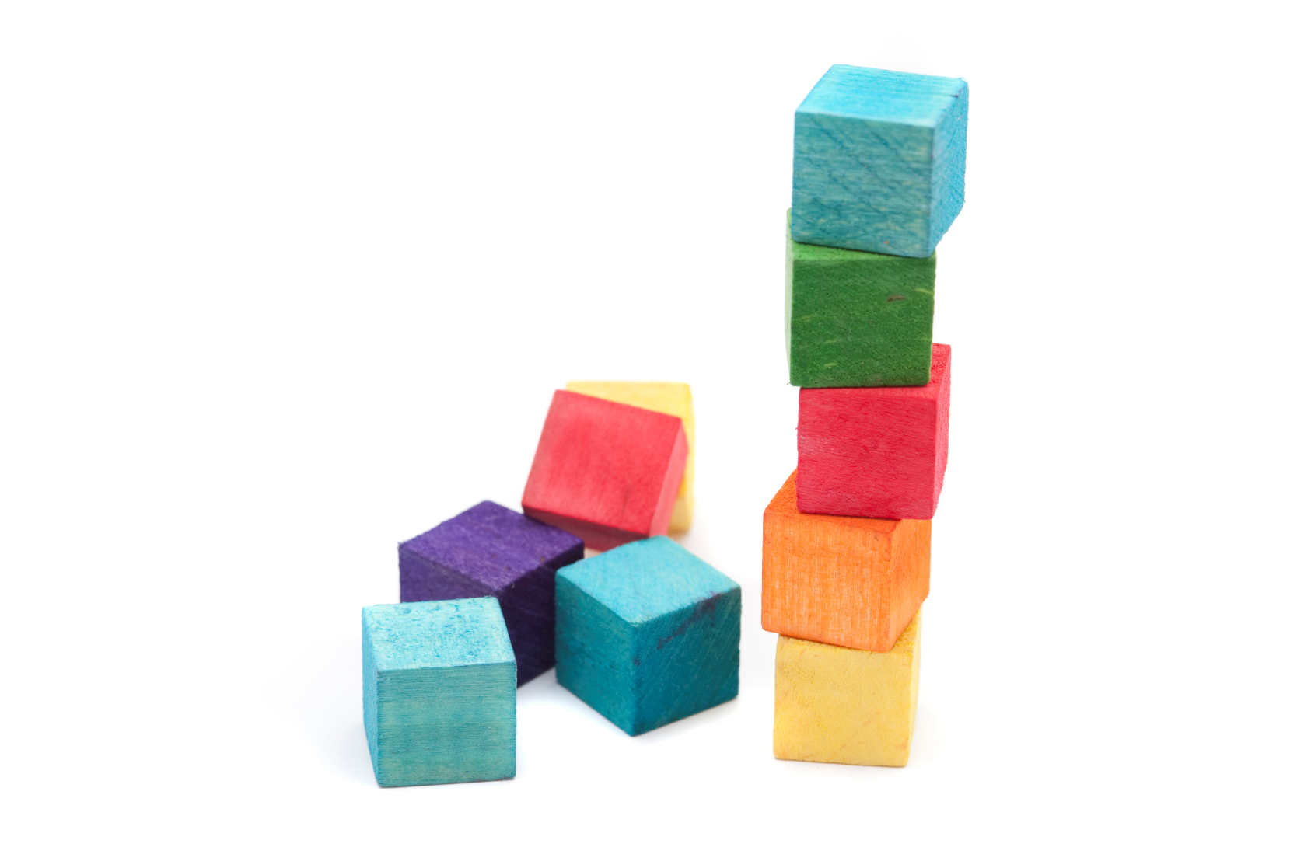
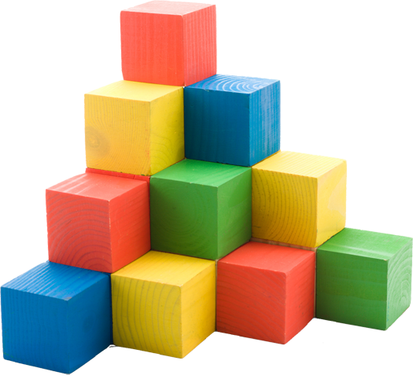
Depth not acceleration
The old curriculum, measured in terms
of levels, encouraged undue pace.
Children were accelerated onto more
complex concepts before really mastering
earlier ones.
The new curriculum
encourages a study of
fewer skills in greater
depth - mastery.
Notes:
Depth is a key word. It’s no longer good enough to be able to be fluent with procedures. Children need to examine and discuss the structure of the Maths in depth in order to be able to reason, make generalisations and apply their understanding to non-familiar problems.

Slide 5
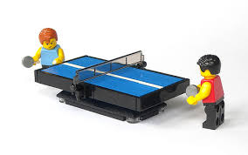
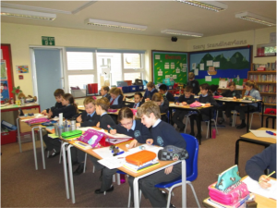
Key Features of Mastery Teaching
struggling learners and fast Graspers
Access and Challenge
Class taught as a whole
Children talk and learn in mixed ability pairs Partners change regularly
Ping Pong style of teaching meaning teacher and pupils interact with each other throughout the lesson as a whole

Slide 6
Mathematics programmes of study state that:
All pupils should become fluent in the fundamentals of mathematics, including..
.. varied and frequent practice, so that pupils develop conceptual understanding and are able to recall and apply their knowledge rapidly and accurately to problems.

Slide 7
Pupils who grasp concepts rapidly should be challenged through rich and sophisticated problems before any acceleration through new content.
Those pupils who are not sufficiently fluent with earlier material should consolidate their understanding, including through additional practice, before moving on.

Slide 8
The expectation is that the majority of pupils will move through the programmes of study at broadly the same pace.
When to progress should always be based on the security of pupils’ understanding and their readiness to progress to the next stage.

Slide 9
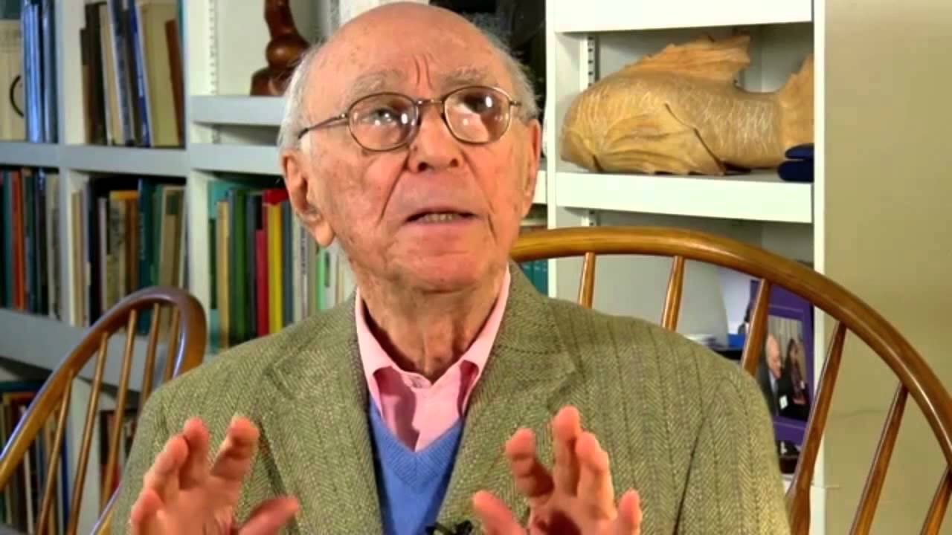
The stages of representation...
Famously, the educational psychologist Jerome Bruner recognised that children have difficulty accessing abstract concepts - like the value of a number compared to the written numeral. Success can be achieved by experiencing three stages of representation:
Concrete / enacting
Pictorial / iconic
Abstract

Slide 10
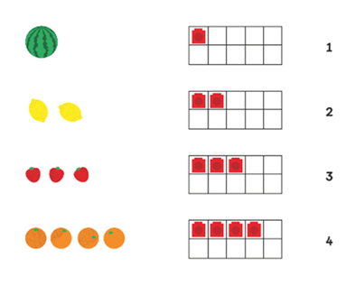
Concrete, Pictorial (iconic), Abstract

Slide 11
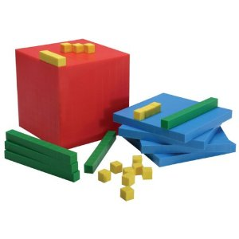
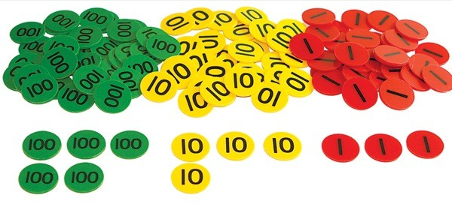
Concrete – with specific values

Slide 12


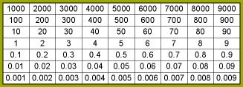

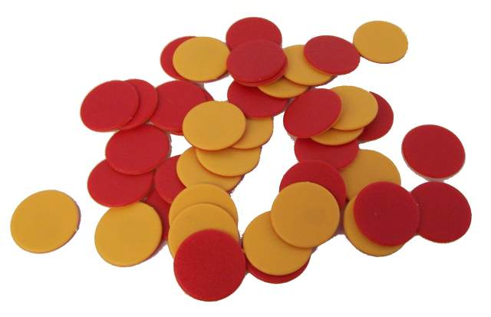
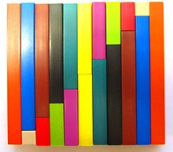
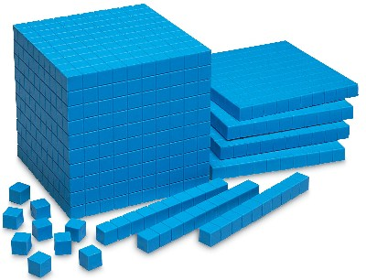
Resources and
Representations of Mathematics
Resources to help build concepts
Ofsted 2013

Slide 13
Have a go…
Make ten in as many different ways as you can with the resources on your table
Now show number bonds to ten in as many different ways as possible
Ofsted 2013

Slide 14

Addition and subtraction model
8
3
?
+
Identification of relationships and making connections supports depth and sustainable learning and paves the way for later learning
=
3 3
+
=
-
=
-
=

Slide 15
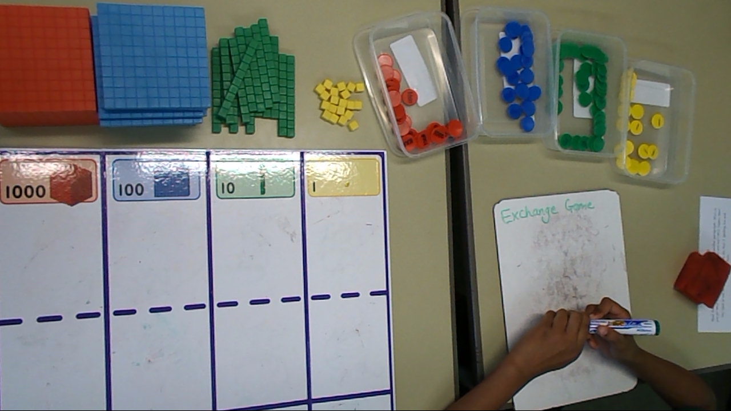
The Exchange Game – the beginning of column addition.

Slide 16
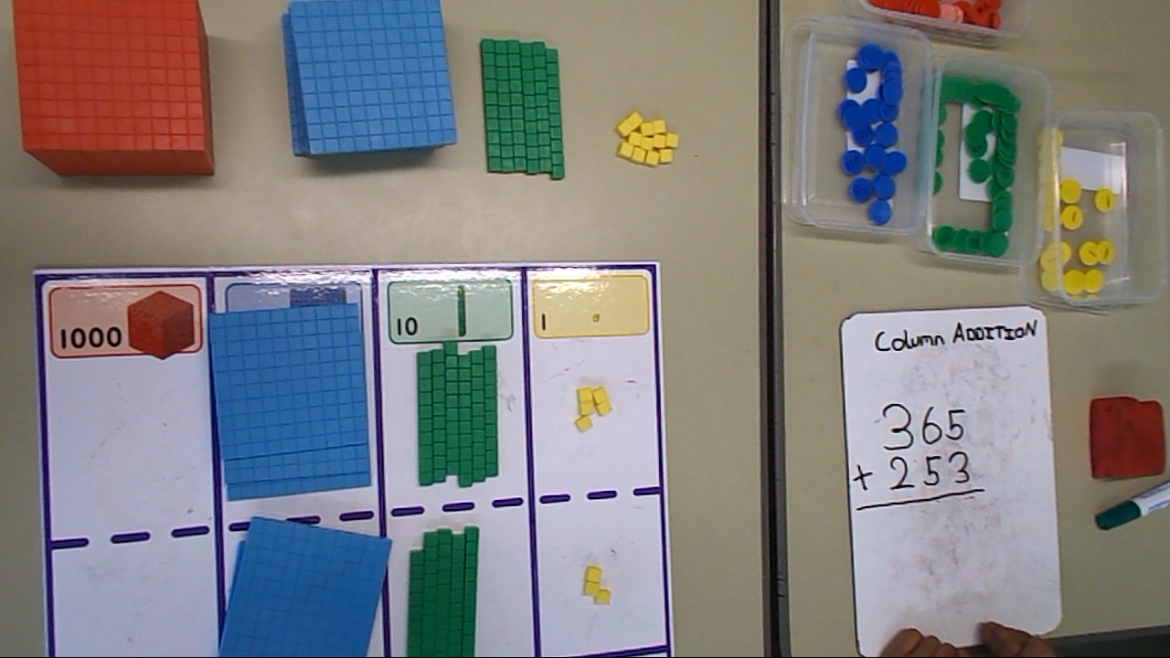
Over to the children
Video of Yr 3 children using resources for column addition (exchanging)

Slide 17
Your turn!
Use the resources to carry out this calculation:
324 + 153 =
Next step is exchanging so now try this one:
473 + 328 =

Slide 18
Prior learning for column subtraction
Pupils need to:
Be fluent in their number facts of single digit numbers
Understand the place value of the digits
Understand the relative size of the digits
Have a good understanding that 47 and 38 can be partitioned into tens and ones
Understand that subtraction is represented by 2 models - take away and difference

Slide 19
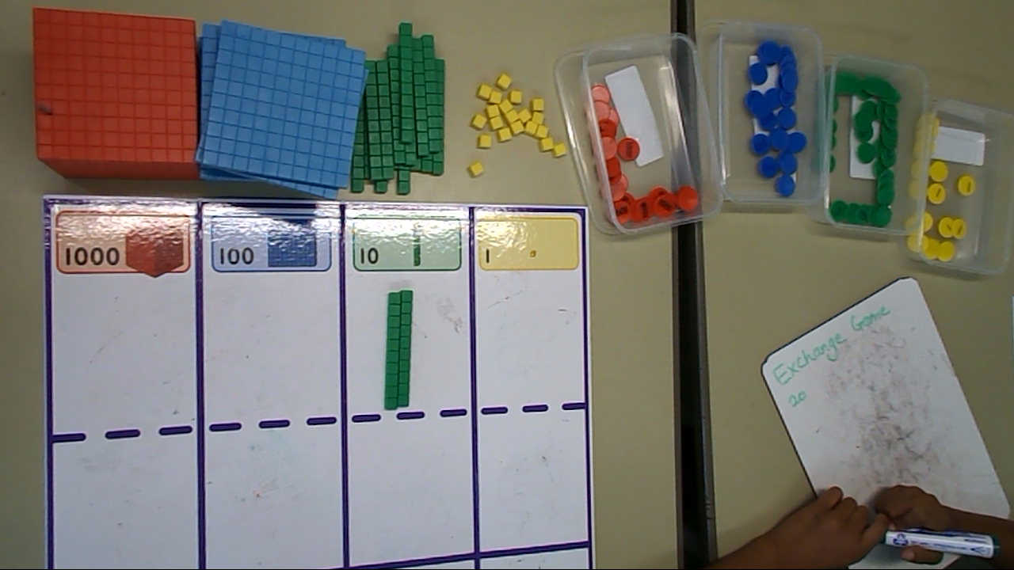
The Exchange Game – for column subtraction.

Slide 20
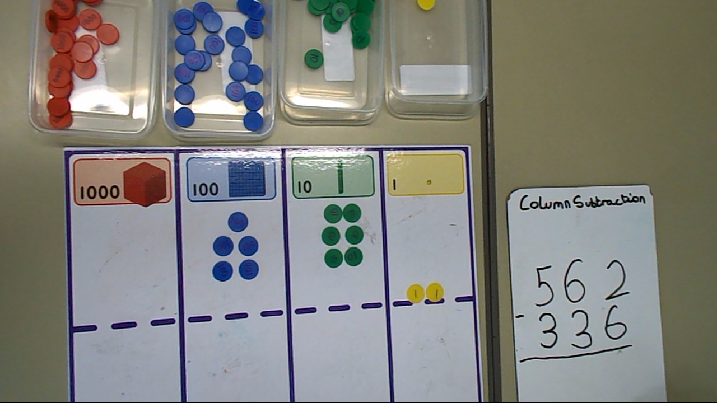
Over to the children
Video of children using resources for column subtraction (exchanging)

Slide 21
Your turn!
Use the resources to carry out this calculation: 354 - 123 =
Next step is exchanging so now try this one: 473 - 328 =

Slide 22
Progression through the stages
Struggling learners often get “stuck” in the concrete stage.
It is important that we move them on and show them how to move through each stage and onto the abstract.
Fast graspers often view the concrete as unnecessary or even ‘beneath them’ but they need to use the resource to explain their reasoning.

Slide 23
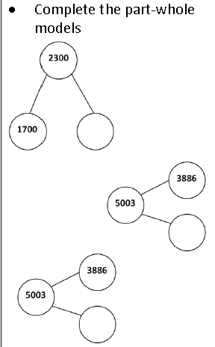
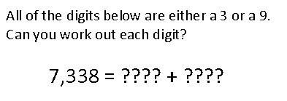
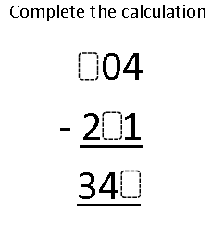
Fluency Reasoning Problem Solving

Slide 24
Multiplication and Division

Slide 25
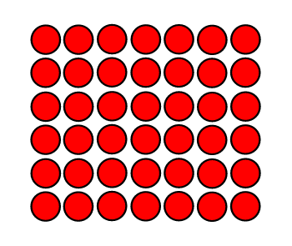
Which is the most useful representation of 7 X 6? Why?
7 x 6 = 42
6 x 7 = 42
7 x (5+1) = 42
(5+2) x (5+1) = 42
7x6 = 42
6x7 = 42

Slide 26
Sally knows all her tables up to 12 X 12
When asked what is 13 X 4?
She looks blank
Does she have fluency and understanding?

Slide 27
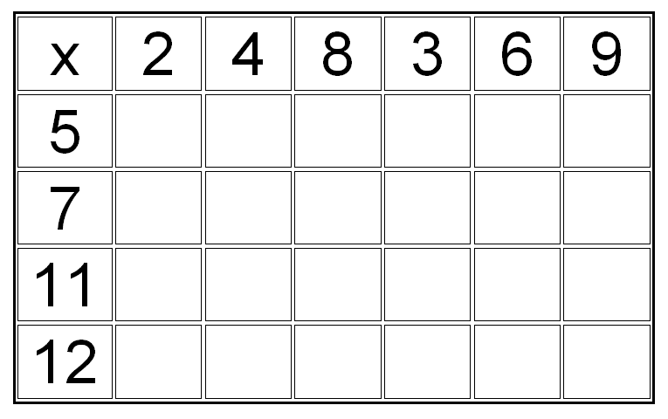
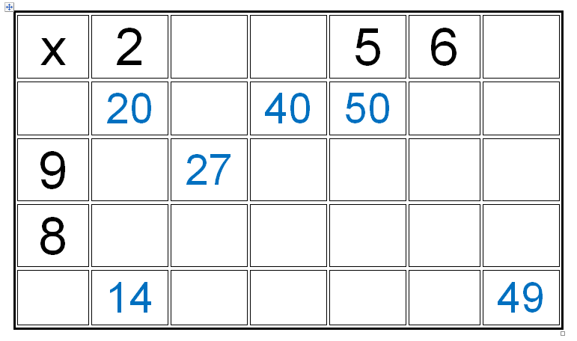
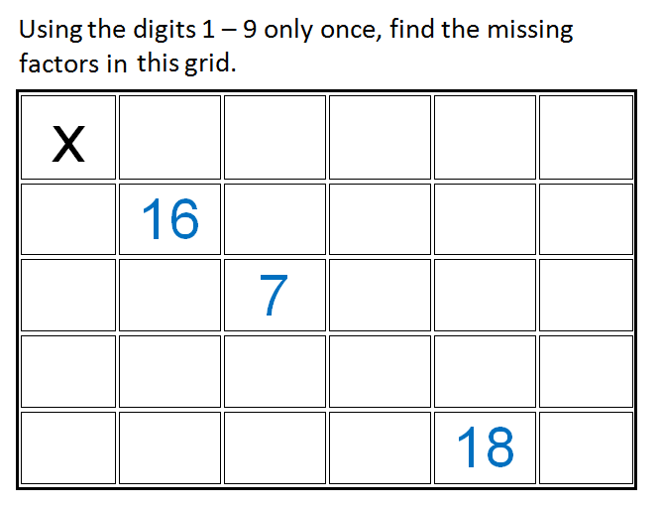
Fluency
Reasoning
Problem Solving

Slide 28
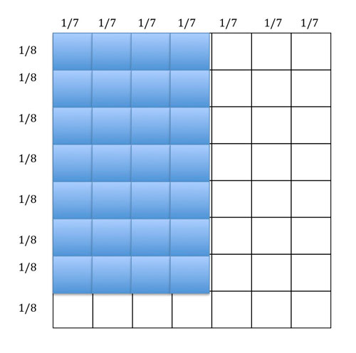
Arrays extend into upper KS2 and beyond 4/7 x 7/8 =
The overall array has been divided into 8 x 7 smaller parts, hence the denominator is 56.
The shaded part is 7 x 4 = 28. So the answer is 28/56 or 1/2.
“Models in Mind,” Mike Askew nrich.maths.org

Slide 29


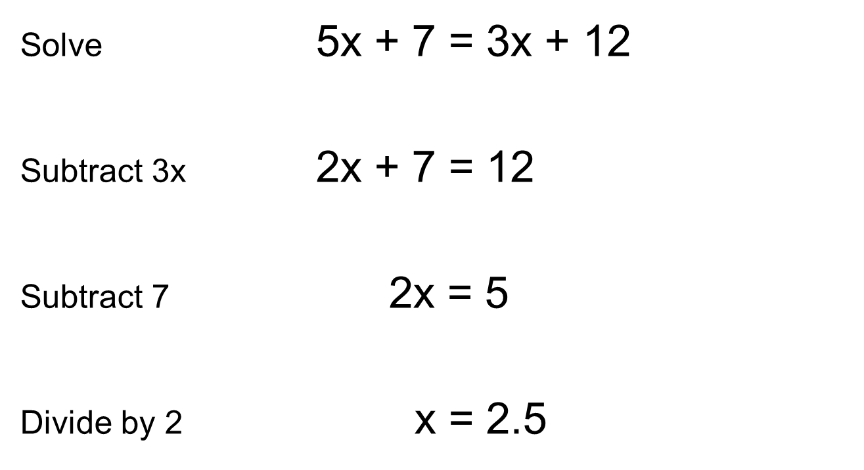
Notes:
Traditional way
Representation and structure is not just something to be used with young children. Consider introducing algebra to children in year 6. The example above is an arithmetic example of solving an algebraic equation. But if algebra was taught with an emphasis on representation and structure what model could we give children to begin to develop a conceptual understanding?

Slide 30
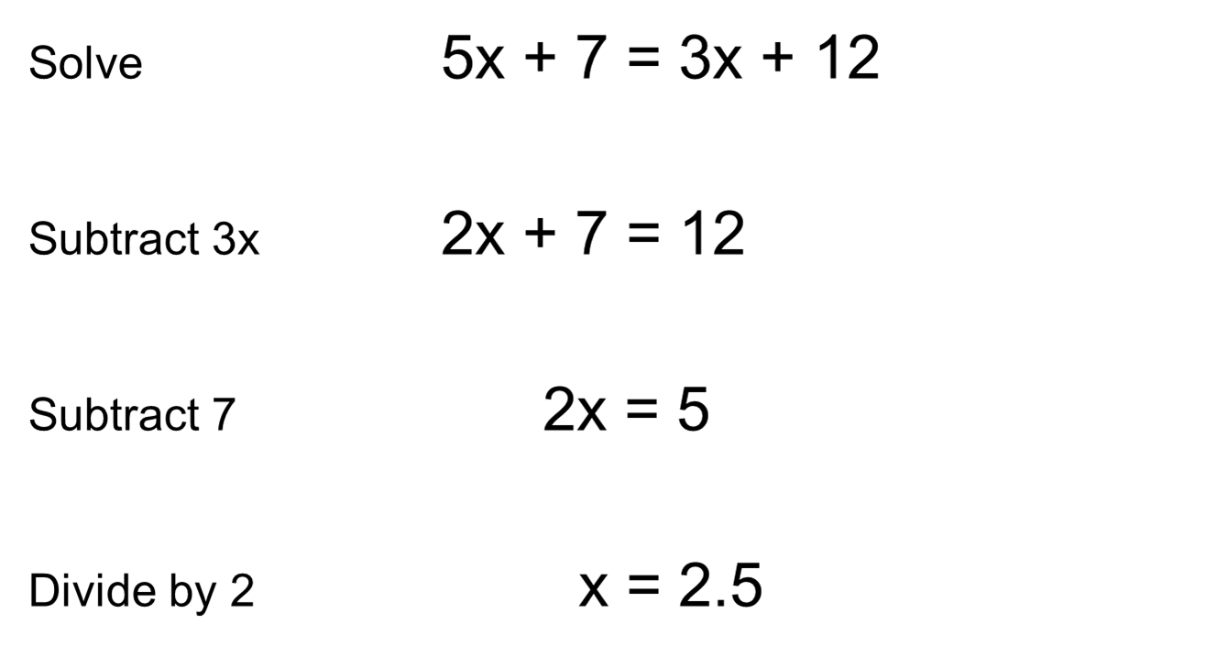


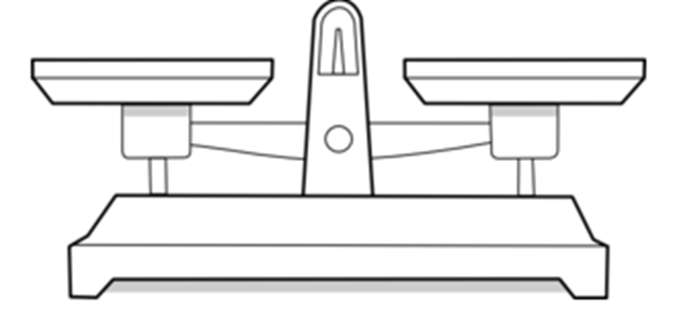

Slide 31
Bar modelling for scaling
Peter has 4 books
Harry has five times as many books as Peter.
How many books has Harry?
4 × 5 = 20
Harry has 20 books
4
4
4
4
4
4

Slide 32

Bar modelling with division
Mr Smith had a piece of wood that measured 36 cm.
He cut it into 6 equal pieces.
How long was each piece?
36 ÷ 6 = 6
Each piece is 6 cm

Slide 33

Bar modelling with division and fractions
Find 1/5 of 30
The same image can be used to find 2/5 or 3/5 of 30 etc.

Slide 34
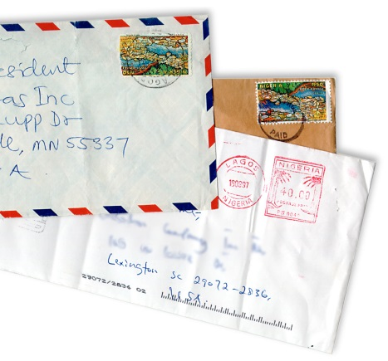
Ralph posts 40 letters, some of which are first class, and some are second.
He posts four times as many second class letters as first.
How many of each class of letter does he post?
Notes:
Have a go

Slide 35
He posts four times as many second class letters as first.
How many of each class of letter does he post?
1st
40
2nd
Class
40 ÷ 5 = 8
8 x 4 = 32
2nd Class 32 letters
1st Class 8 letters
8
8
8
8
8

Slide 36
What is Mastery?
Deep and sustainable learning in small steps
The ability to build on something that has already been learnt.
The ability to reason about a concept and make connections.
To have conceptual and procedural fluency.

